Slide 1
ECE 3300L
Lab 10:FIFO Controlling RGB
Instructor: Dr. Mohamed El-Hadedy
Sami Elias, Joseph Popoviciu

Slide 2
Objective
Create a push/pull module using FIFO.
Load 12 bits of data into the FIFO until it is full
Pull 12 bits into the synthesiser module
Break them up into three 4-bits which are wired to each color of the RGB LEDs and control their resolution

Slide 3
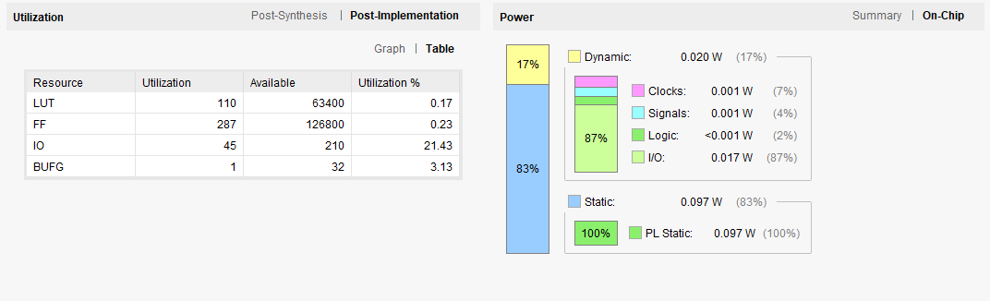
Results

Slide 4
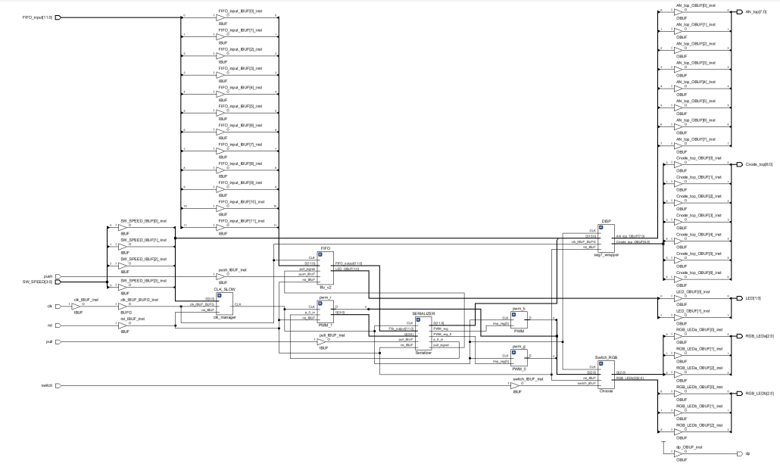
Results Cont.

Slide 5
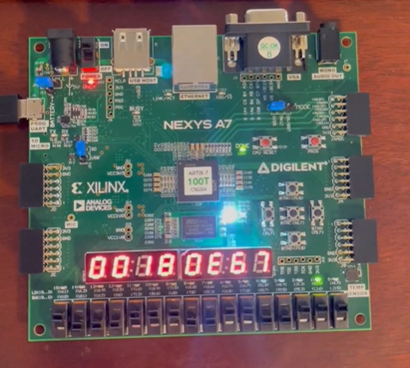
How it works
Left four switches control clock
frequency
Rest of switches control Data
pushed into the FIFO
Two LED’s on the right indicate
if the FIFO is full or empty
The buttons control pushing,
Pulling, reset,
and selecting the RGB

